Slide 1

COMPUTER SCIENCE CLUB
COMPUTER SCIENCE CLUB
Intro to Competitive Programming (Pt. 5)
Roy Zhang

Slide 2
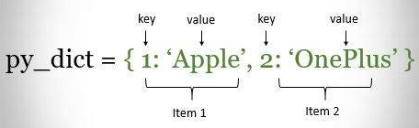
What is a Dictionary?
Stores information in key value pairs
Lists:
Has indexes
O(n) look up
O(n) deletion
O(1) look up (using index)
Dictionaries:
No indexes
O(1) look up
O(1) deletion

Slide 3
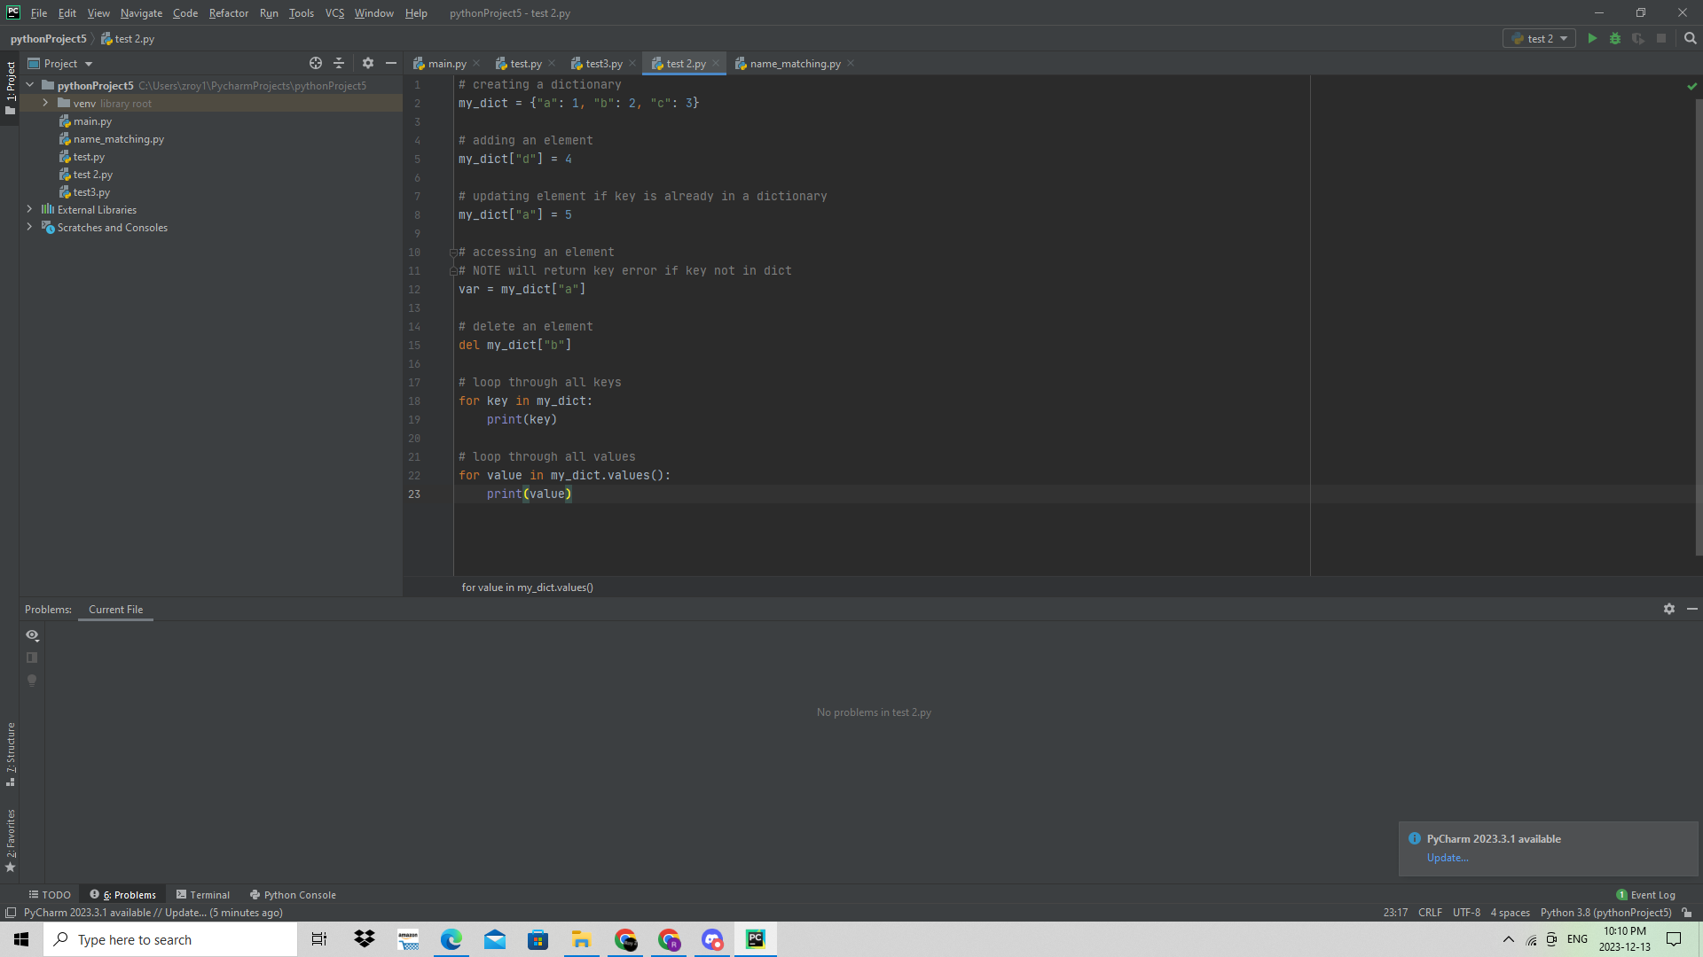
Dictionaries in Python

Slide 4
Looping through dictionaries

Slide 5
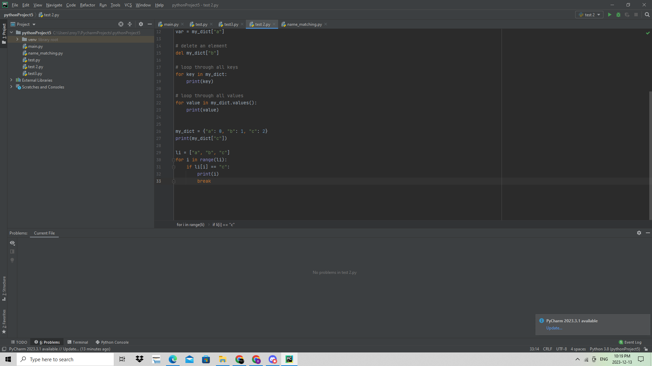
Why use dictionaries in CCC?
Can often be faster than lists due to its O(1) lookup time
In the following data structures find the index/value of the letter “c”
O(1) Much faster!
O(n) Much slower

Slide 6
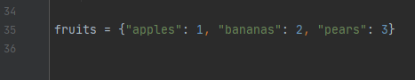
Why use dictionaries in CCC?
Easier to model certain information
Store the following information in a data structure:
Apples cost 1$
Bananas cost 2$
Pears cost 3$

Slide 7
Problems
Beginner:
https://dmoj.ca/problem/ccc06j3 - CCC '06 J3 - Cell-Phone Messaging
Intermediate:
https://dmoj.ca/problem/ccc10s2 - CCC '10 S2 - Huffman Encoding
Advanced:
https://dmoj.ca/problem/ccc07s3 - CCC '07 S3 - Friends

